Slide 1

Student Details
Name : Tadepalli Divya sri
Roll No. : 22X41A0457
Email I’D : divyahanutadepalli@gmail.com
College Name : SRK Institute Of Technology
College State : Andhra Pradesh
Internship Domain : Cyber Security With Kali Linux Start. Dt : 3rd –June -2024 End Dt. :12th –July -2024

Slide 2

PROJECT TITLE/Problem Statement
HIDING A TEXT INSIDE AN IMAGE USING STEGANOGRAPHY
While sharing a text(secret message), it may be
vulnerable to interception, tampering, unauthorized
access and etc..
To overcome this using steganography, the information
can be hidden in carriers such as images, audio files, text
files, videos and data transmissions. Image steganography

Slide 3

AGENDA
The main agenda of the project is
To develop a program to hide text messages inside images using steganography
techniques.
To transfer the data secretly
Without any interception by hiding
the text in a cover image.

Slide 4

PROJECT OVERVIEW
Requirement of this steganography system is that the hider message carried by
stego-media should not be sensible to human begins.
The scope of the project is to limit unauthorized
access and provide better security during message
transmission. To meet the requirements, I use the
simple and basic approach of steganography.
This project aimed to develop a steganography tool, to hide a text(secret message)
inside images, ensuring confidentiality and privacy.

Slide 5
WHO ARE THE END USERS of this project?
This approach of information hiding technique has recently become important in a number of application areas. Some of them are
For the privacy & security in communication purpose, such as journalists, activists, military personnel and etc..
Some organizations and businesses uses this method to protect sensitive information, such as intelligence agencies, law enforcement agencies and etc..
Some financial institutions and researchers, such as banks, credit unions, investment firms, medical researchers and etc..

Slide 6
YOUR SOLUTION AND ITS VALUE PROPOSITION
A secret message is embedded into the cover image(original image),then that message and image combined makes a stego image.
This digital image is given to the receiver and then decoded by the receiver to get the corresponding secret text message.
It’s a user-friendly interface for easy hiding and retrieval of text messages.
This keeps sensitive information confidential and private, enhances security and privacy for individuals and organizations.
This also verify authenticity and detect tampering in images and protect personal or professional communications from unauthorized access.

Slide 7
How did you customize the project and make it your own
The steganography process is efficient and does not significantly alter the original media file's quality or characteristics, preserving its integrity and minimizing the chances of detection.
By using problem statement this project is created to hide a text inside an image using a cover image for imperceptible to the human eye.
The secret message is hidden inside the cover image and the encrypted image is sent to receiver.
This project is customized only to hide a text inside an image and can only unhide the image who has secret key others are not able to see the hidden secret message.

Slide 8
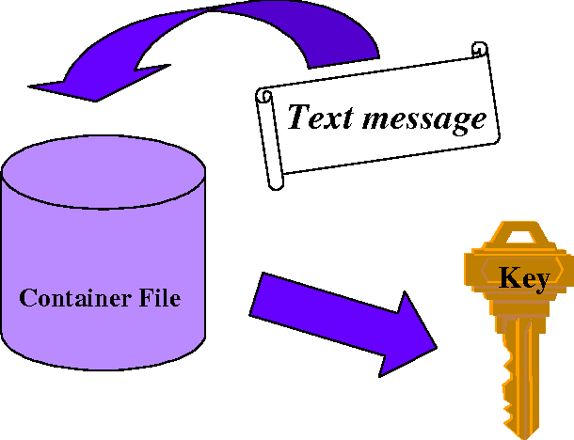
MODELLING
At sender side:
Step 1: Choose an Image and Text
Select an image (JPEG, PNG) and text message to hide.
Step 2: Convert Text to Binary
Convert the text message into binary format.
Step 3: Save the Modified Image
Save the image with embedded text securely.

Slide 9
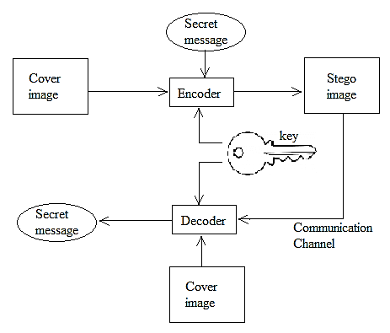
MODELLING
At receiver side:
Step 1: Obtain the Encoded Image
Retrieve the image that contains the hidden text.
Step 2: Convert Binary Data to Text
Convert the extracted binary data back into readable text format.
Step 3: Display or Output the Decrypted Text
Present the decrypted text message to the user or save it as required.

Slide 10
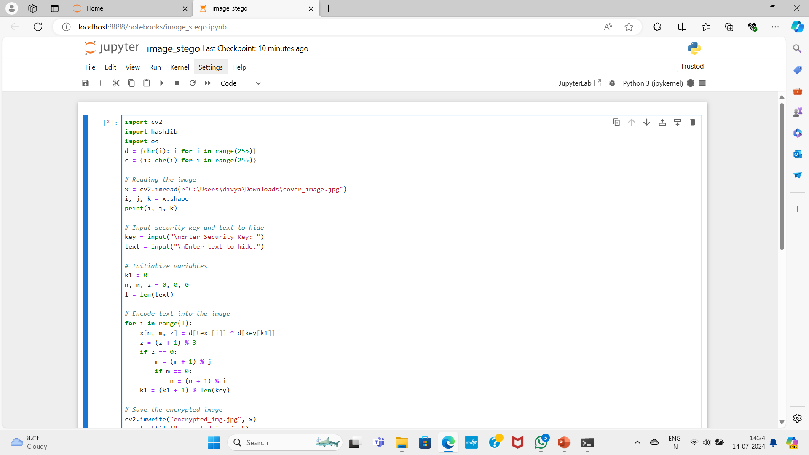
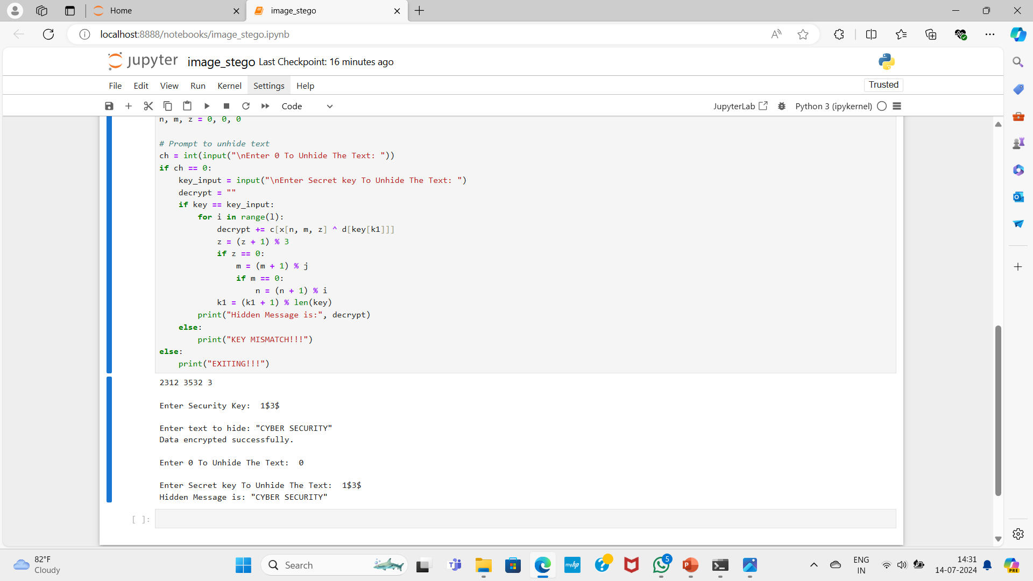
Results

Slide 11
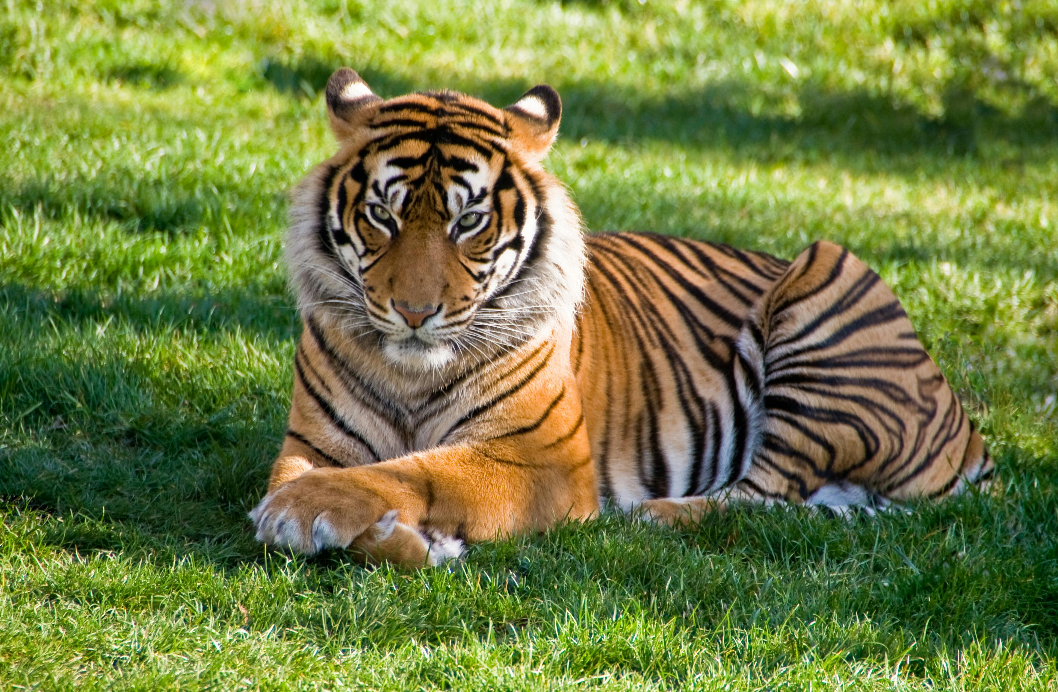

Results
COVER IMAGE
ENCERYPTED IMAGE
SECRET MESSAGE: “CYBER SECURITY”

Slide 12
links
GITHUB LINK : https://github.com/DivyasriTadepalli/Image-Steganography

